Slide 1

Rotary’s
Peace Centers and Peace Fellowships
Notes:
Our District has long supported Rotary International’s scholarship programs.
We actively participate in two RI scholarship programs;
Rotary Peace Fellowships
and
Rotary Global Scholarships.

Slide 2
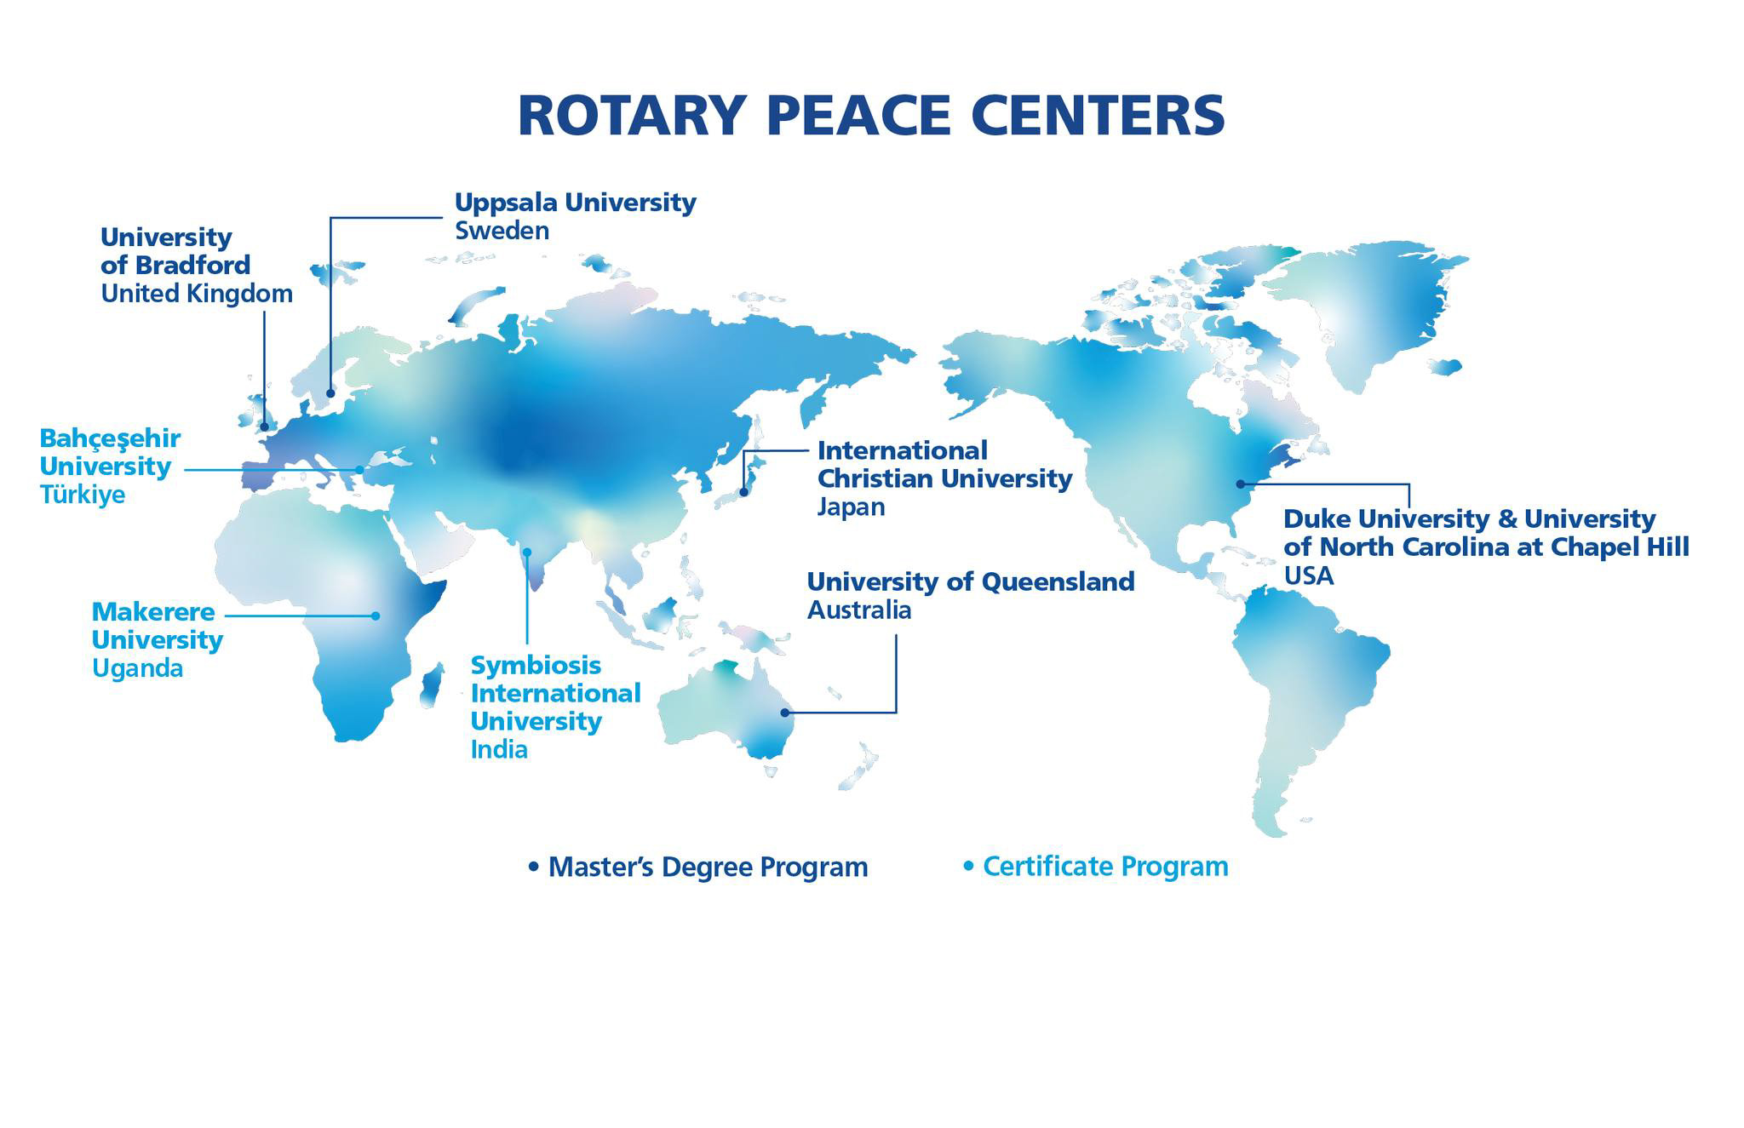
Notes:
Five Peace centers:
Bradford, England
Uppsala, Sweden
ICU, Tokyo, Japan
Queensland, Brisbane, Australia
Duke-UNC, USA
Three Certificate centers:
Kampala, Uganda
Istanbul, Turkey
Pune, India, opening in 2027
RI is exploring opening a Peace Center in South America

Slide 3
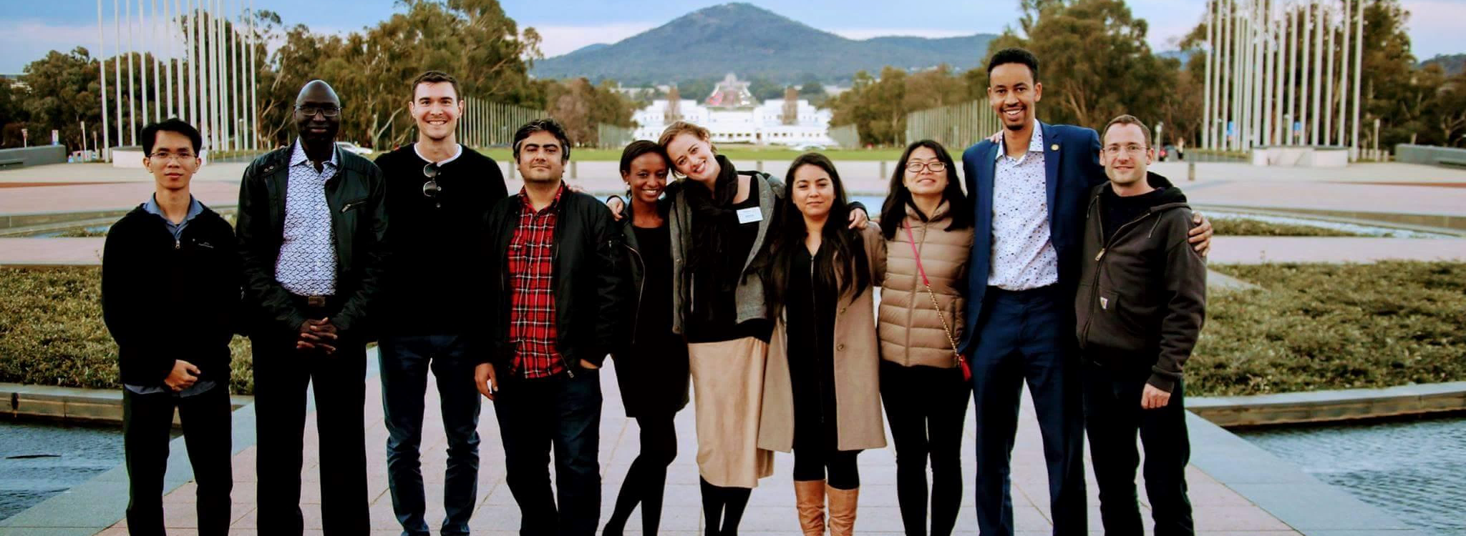

Rotary Peace Fellowships
Notes:
Rotary Peace Centers train and create a network of peacebuilders and community leaders dedicated to preventing and resolving conflicts around the world.

Slide 4
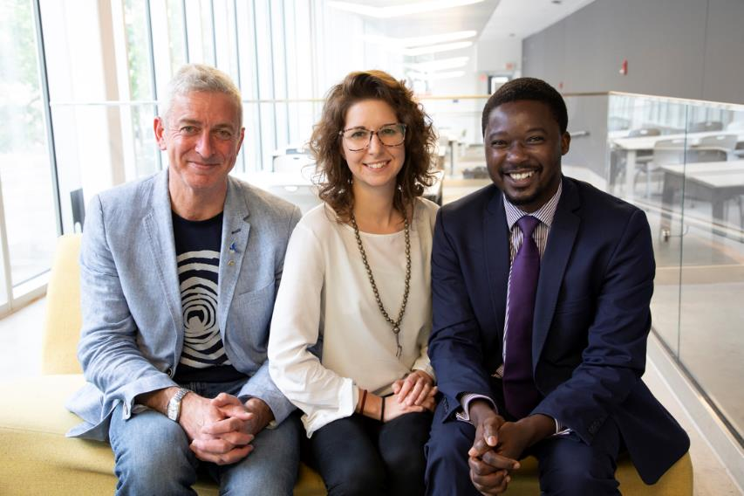
Master’s program:
Those near the start of their careers - minimum 3 years work experience
50 fellows per year (10 per center)
15–24-month course, including field work
Certificate program:
Proven peace and development leaders – minimum 5 years work experience
Up to 10 fellows per year
One-year academic + fieldwork program intended for working professionals
Master’s and Certificate programs
Notes:
Rotary Peace Fellows are selected to earn a master’s degree or a professional development certificate.
The two programs were created to provide those near the start of their careers, as well as those with more extensive work experience, with the educational opportunities that will further their careers in peacebuilding and development.
Each year, 50 Fellows are admitted to a Master’s degree program that lasts from 15 months to two years.
In addition, up to 130 fellows will participate in Rotary’s one-year post-graduate certificate program.
Certificate fellows must do their field project in the region of the Certificate Peace Center they attend.

Slide 5
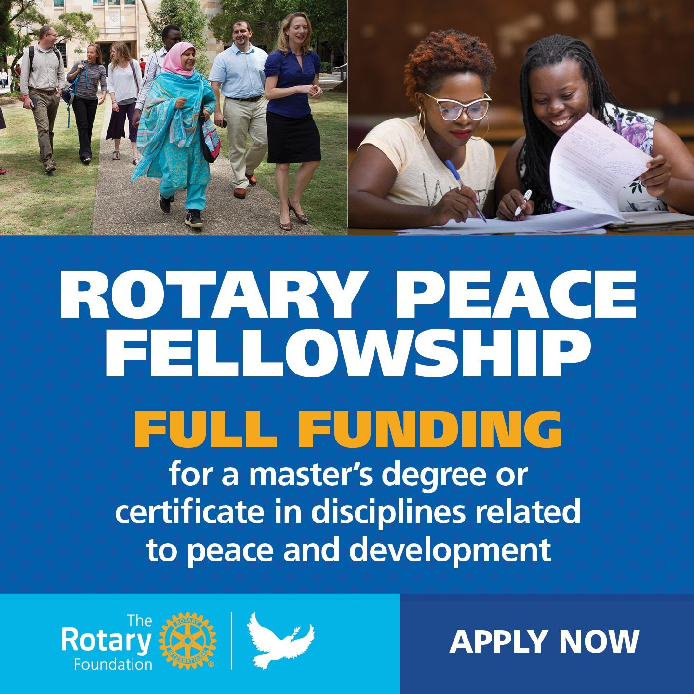
Proficient in English
Have a bachelor’s degree
Demonstrate leadership skills
Strong and proven commitment to cross-cultural understanding and peace
3-5 years full-time experience in peace or development work
Must study outside of their home country.
Certificate candidates must explain alignment of their peace plan with Rotary’s mission
Notes:
These scholarships are full-ride scholarships, each roughly $100,000 per year, depending on the Peace Center.
The main requirements are the 3–5-year full-time work experience in a peace-related field and that the candidate must study at a Peace Center outside their home country.

Slide 6
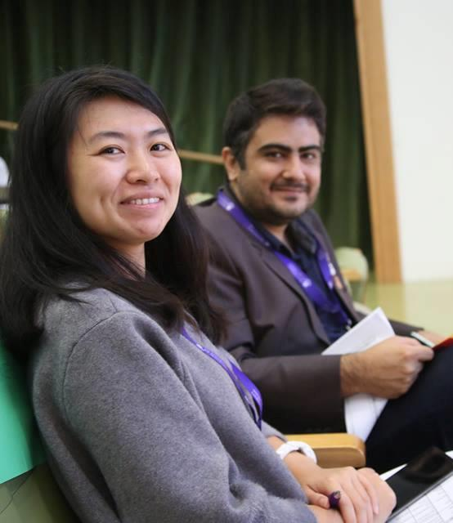
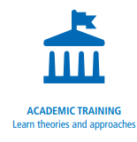


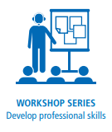
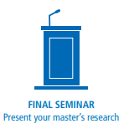
Master’s program
Fellowship components
Notes:
Teaching in the master’s programs is grounded in practical research. Students are enrolled graduate students with diverse backgrounds and professional experience.
Fellows selected for the master’s program benefit from:
Academic training with diverse curricula. The centers build on the unique strengths of their university hosts and offer courses that examine peace and conflict through various frameworks. At all centers, the core coursework includes peace and conflict resolution with a focus on negotiation, mediation, human rights, or international development.
A fully funded applied field experience of 2-3 months that they design and carry out--an opportunity to put theory into practice.
Opportunities to network with a cohort of diverse peace fellows as well as with Rotarians at home and in their host countries.
A Rotary-sponsored workshop series that helps them develop professional skills in resiliency.
The chance to present their research during an annual seminar hosted by the universities and local Rotarians.

Slide 7
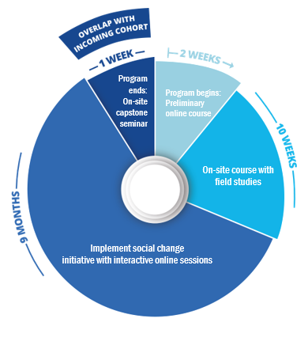
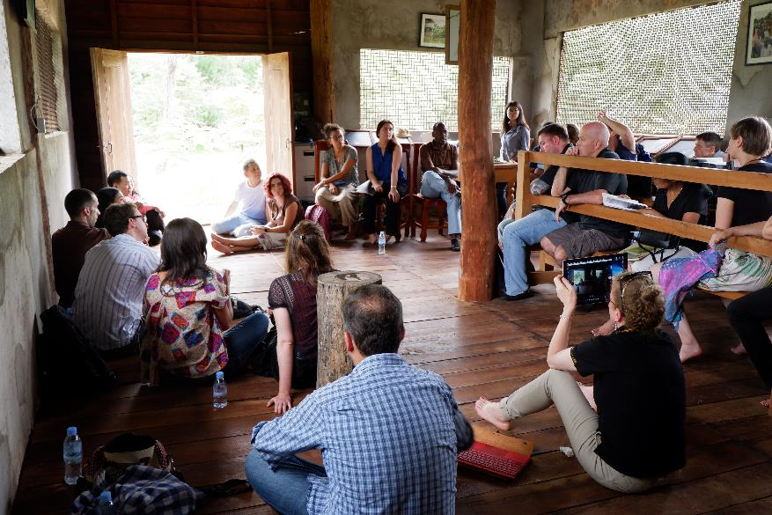
Certificate program
Fellowship components
Notes:
The professional development certificate program is aimed at mid-career peace and development leaders with at least five years of relevant work experience. This program is intended for working professionals and requires 11 weeks of on-site participation. Fellows earn a post-graduate diploma upon completion of the program.
During the one-year program, students with diverse backgrounds and professional experience gain practical skills to promote peace in their communities and around the globe. Candidates need to come to the program with a social change initiative to promote peace and development within the program region and have a clear vision of how the fellowship experience and network will help advance their peace work and increase their impact.
Rotary selects a cohort of up to 20 peace fellows twice per year for each center. The cohorts will have some overlap to encourage a sense of community and increase networking opportunities.
The program includes:
An online preliminary course that provides baseline knowledge and sets expectations for incoming fellows
A 10-week on-site course that includes field studies
A 9-month independent project period, with interactive online sessions, during which fellows work on a social change initiative in their community or workplace.
A one-week capstone seminar for fellows to reflect and report on their Positive Peace efforts and impact.

Slide 8
Notes:
The leading statistic here is that 93% of Peace Scholars continue to work in peace and conflict resolution and prevention.

Slide 9
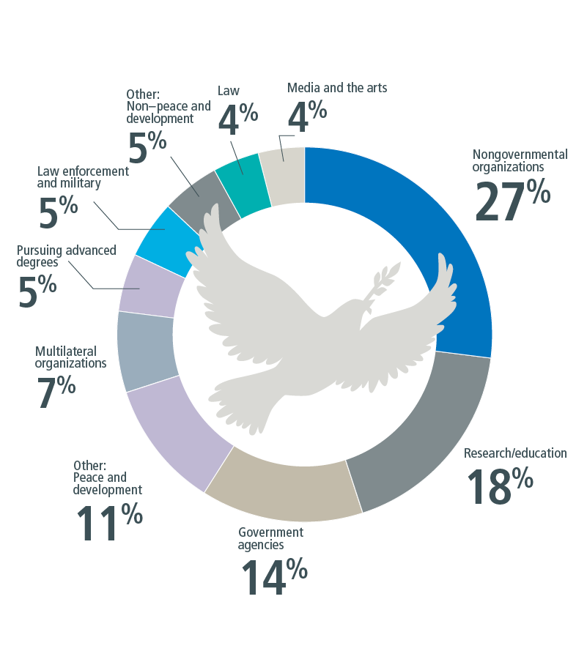
Program alumni serve as leaders in government and nongovernment agencies, education and research, multilateral organizations such as United Nations agencies and the World Bank, law enforcement and the military, law, media and the arts, and other peacebuilding organizations.
Notes:
93% of the more than 1,500 working alumni say they are in jobs connected to peace and development in more than 115 countries.
27% work as leaders of nongovernmental organizations
18% work in research and education
14% serve in government agencies
11% work in other peace and development work
7% work for multilateral organizations
5% are pursuing advanced degrees
5% work in law enforcement and military
4% work in law
4% work in the media and the arts and peacebuilding

Slide 10
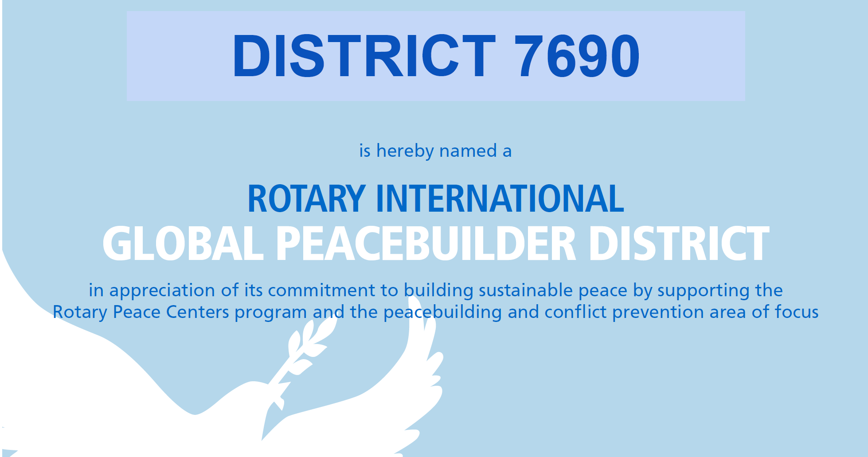
Notes:
The Rotary Foundation funds the Rotary Peace Centers and Peace Fellows programs.
Our District is a Peace Builder District, one of only 31 Peace Builder Districts, out of a total of 530 Districts worldwide. Our District provides $25,000 annually to help sustain the Peace Fellowship program.
Rotarians in our District were instrumental in establishing a Peace Center here in our backyard —the only one in the Western Hemisphere. This center is the only program shared by two universities, in this case Duke University and UNC Chapel Hill, proving that peace is possible anywhere in the World.
For those Duke and UNC fans here, note that it was Dr. John Abels, a Duke professor, that offered the hand of peace to UNC, suggesting the two universities do a joint application for a Peace Center.

Slide 11
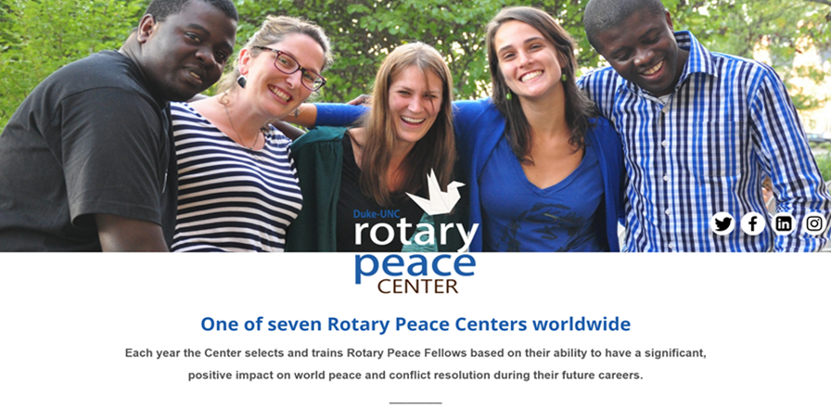
Duke-UNC Peace Center
Notes:
Each April the Duke-UNC Rotary Peace Center has a Peace Symposium where the graduating Peace Scholars present their research project.
At lunch, each table has a Rotary Peace Scholar alum, or a Peace Center professor serving as the table host. It is a wonderful opportunity to speak personally with a Scholar and hear their story.
The next Symposium is on April 3, 2027.
These symposiums are a wonderful experience.
Videos of past conferences are available on rotarypeacecenternc.org.

Slide 12
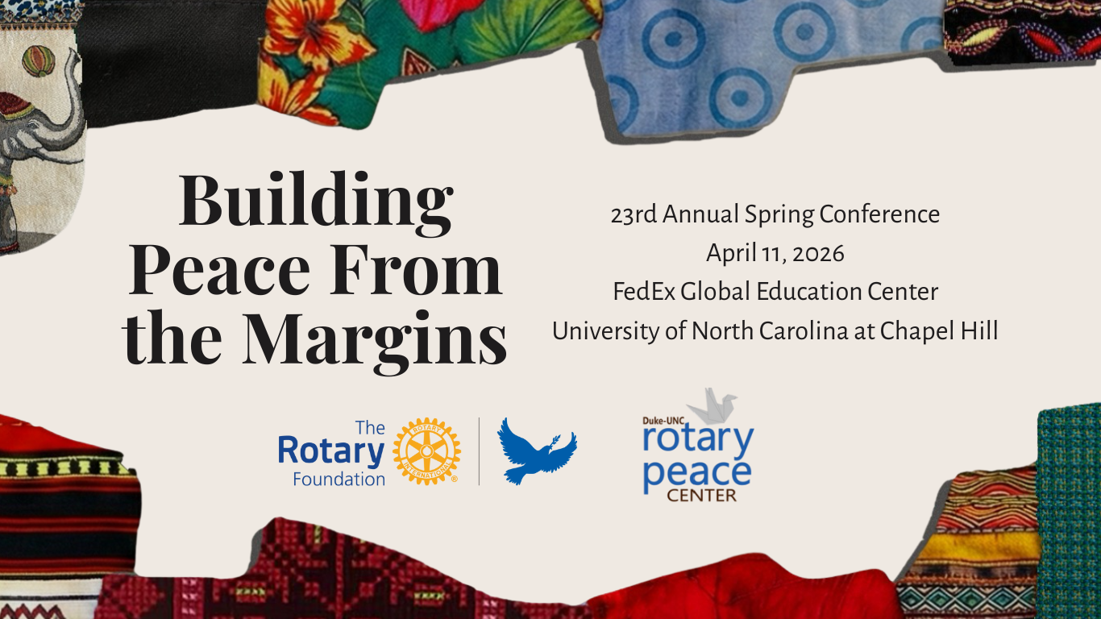
Notes:
Image from this year’s Peace Symposium.
2027 Duke-UNC Peace Symposium
April 3, 2027

Slide 13
2024-26 Graduating Duke-UNC Peace Fellows
Brazil – Lilian Vogt “Social Capoeira: Rebuilding the Circle Around Children Affected by Armed Conflict”
Ethiopia – Tibeb Asfaw “Peace Was Late: We Shoe UP When the Story is Already Written”
Ethiopia – Hanan Abafita “One Health for Peace: A Systems Approach to Peace and Stability”
Ethiopia – Abdulhafiz Kedir “The First Circle of Peace: Healing the Peacebuilder from the Family Up”
India – Sharmeen Indorewala “Healing (In)justice: Beyond the Secondary Prisonization of Partners in Incarceration”
Nepal – Nishchhal Kharal “Why Artivism Works: Closing the Strategic and Creative Gaps in Social Movements”
Rwanda – Debby Karemera “Justice Under the Tree: Gacaca Courts and /Community-Based Peacebuilding in Rwanda”
Sri Lanka – Priskila Arulpragasam “Stories in Fabric: Healing, Resilience, and Peacebuilding through Art Together”
The Levant (Gaza) – Khaled Shaath “Coding for Peace: Rebuilding Hope from Gaza”
Uganda – Oliver Ebwor “Advancing Conservation for Peaceful Coexistence”
United Kingdom – Rory Newberry “How We Gather, and Why It Matters”
Yemen – Mohammad Fekhry “Dying from Distance: Health Equity on North Carolina Farms”

Slide 14

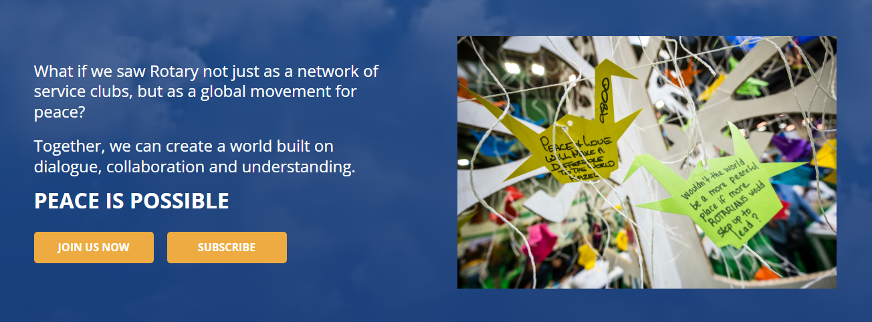

Slide 15
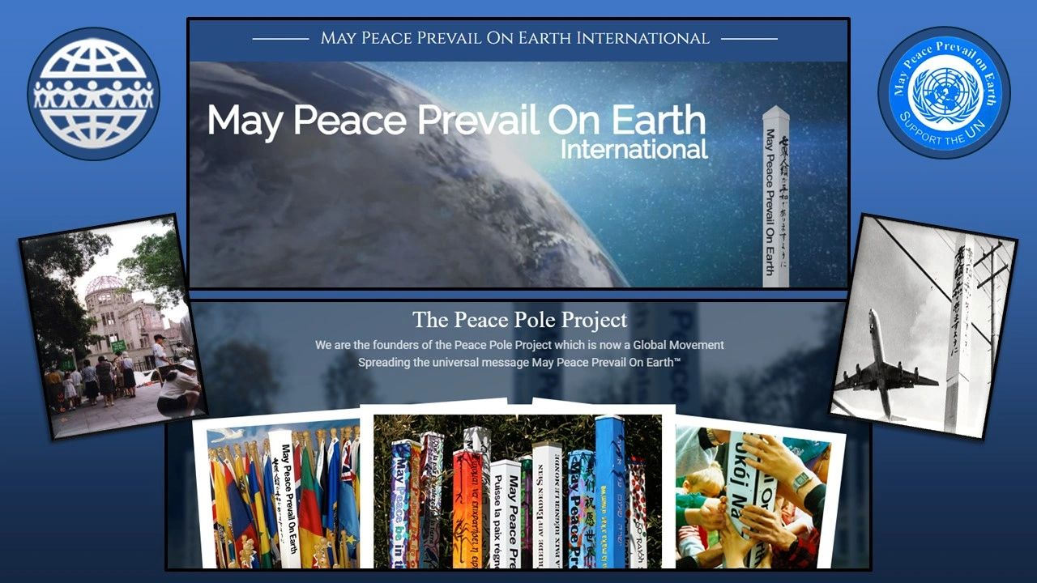

Slide 16
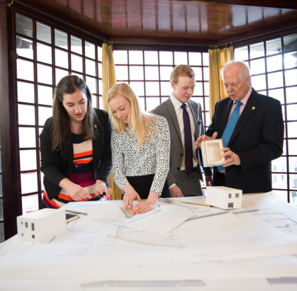
For further information:
Scott Wagoner
scottwagoner62@gmail.com
(336) 989-1971

